Slide 1

WIZARD CHESS
Group 21: Tom Heysel (tomahawk), Dennis Grajo (big D), Matthieu Roux (rouxbacca), Ryan Kinsella (raw dawg), & Allison Christensen (alligator)

Slide 2
Idea
Autonomous chess board, with automatically moving pieces
Voice controlled – use a key phrase to activate the board
Uses magnets and an X and Y track to move the pieces
Allows two people to play a full game of chess
Perfect for people with limited mobility, chess players, Harry Potter fans!
Must be connected to Wi-Fi for command recognition
Must be connected to an outlet for power

Slide 3
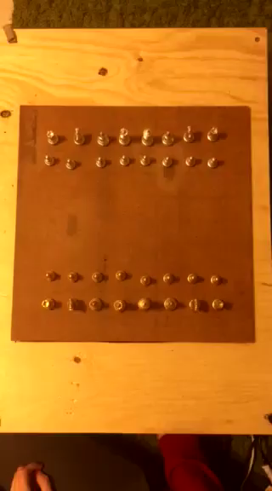
Lil demo video

Slide 4
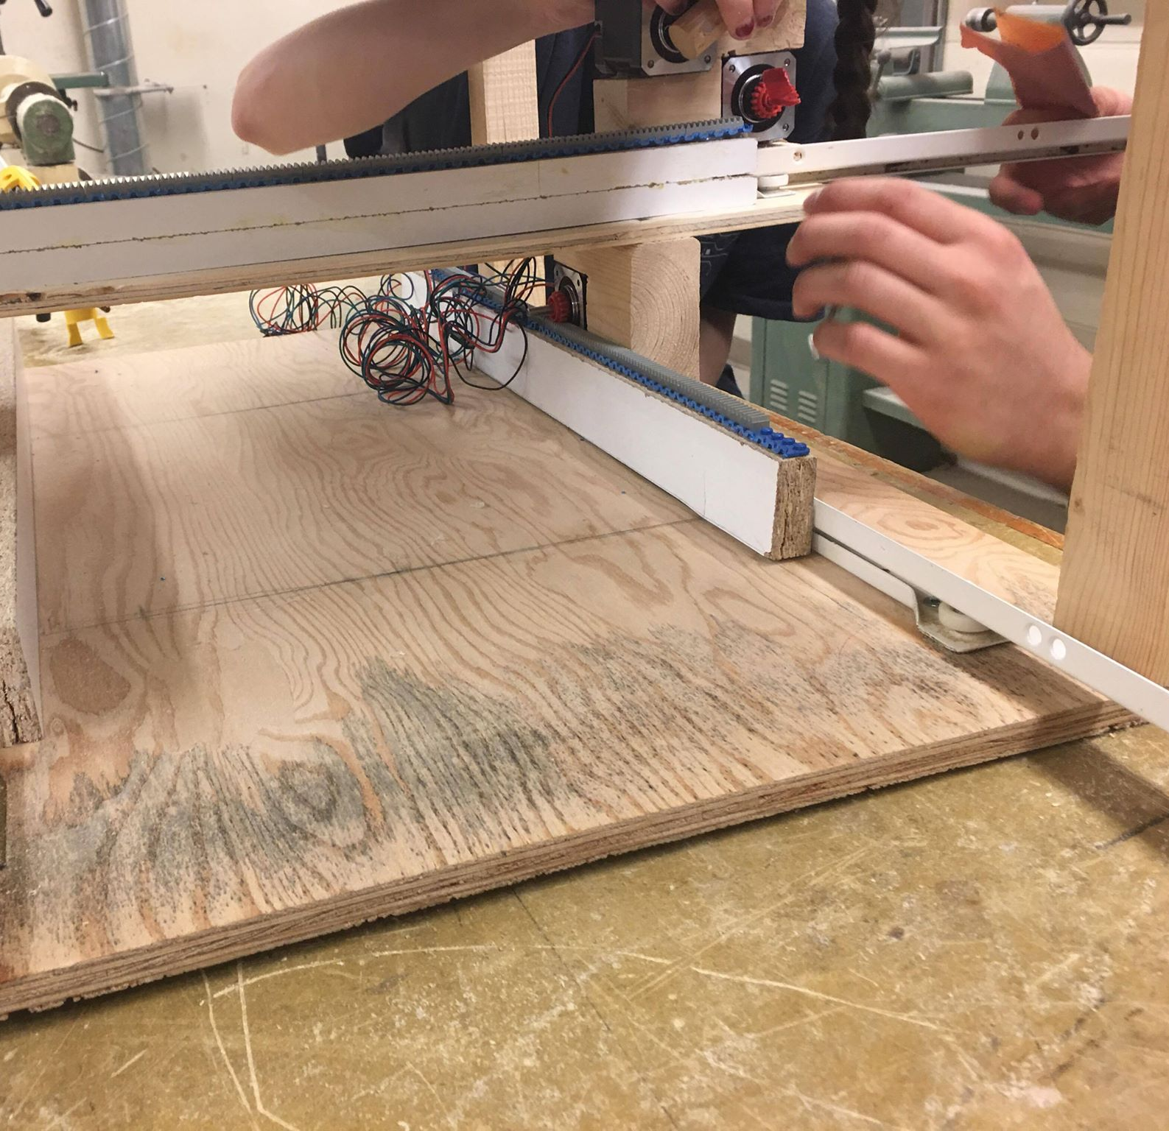
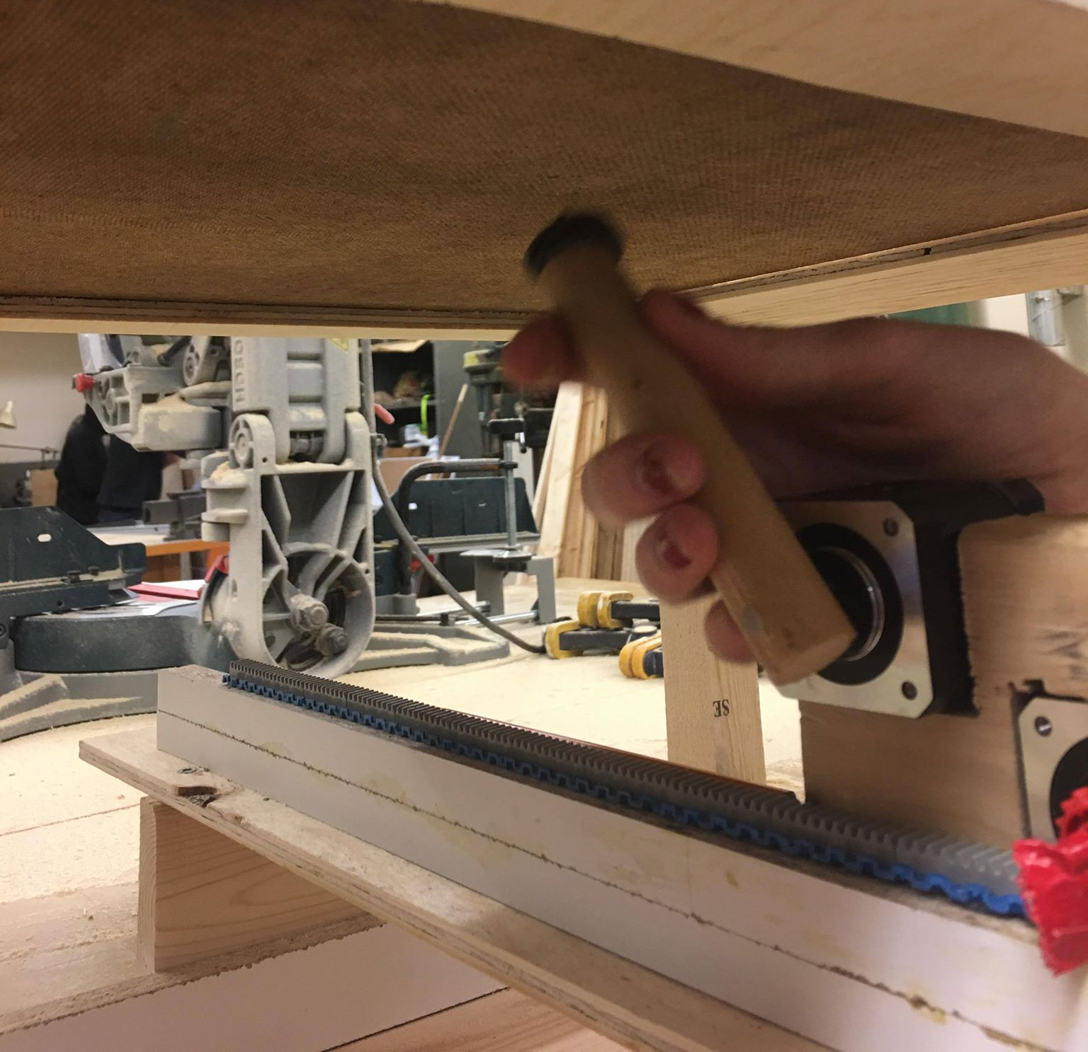
Implementation
Components:
Master ~ Raspberry Pi 3
Slave ~ Arduino Uno
Mechanical Control ~ Longruner CNC Kit and Lego
Speech Recognition ~ Google Speech API and Snowboy

Slide 5
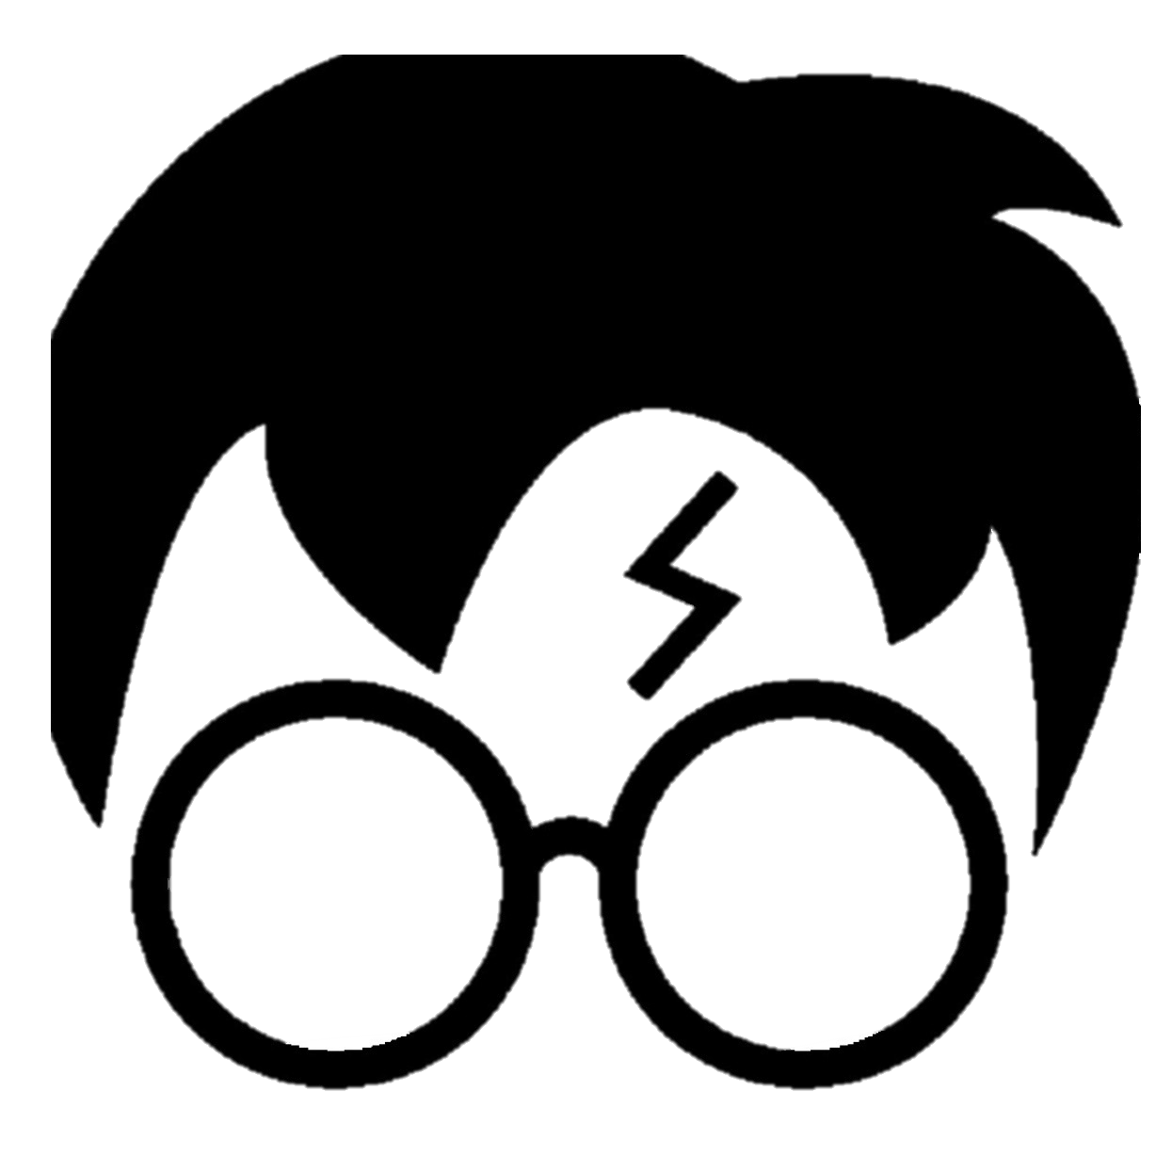
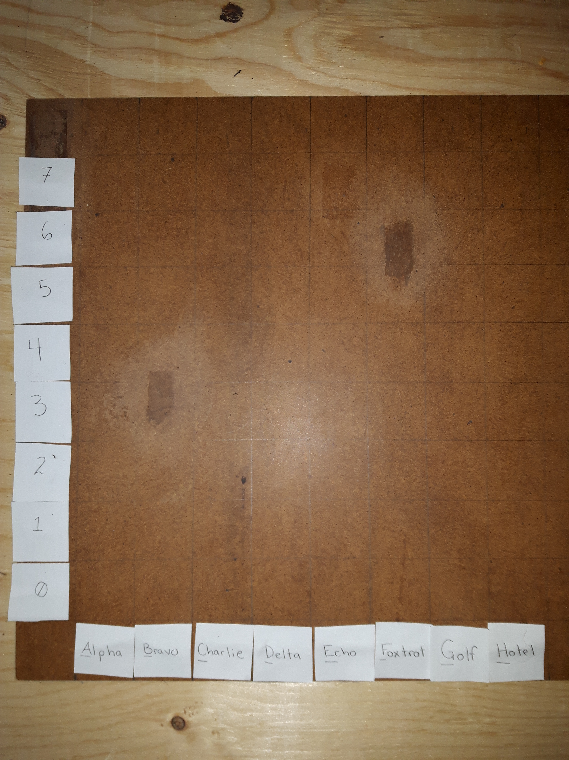
Interactions
User centered design and performance:
Determined that we should make sure that the user hands a hands free chess game.
Limit the amount of bugs or need to re-submit correct inputs.
Design constraints:
Budget of $250, spent $140.
Integrating the Arduino/CNC 3D printer kits to the raspberry pi chess game logic.
Organizing our workload based off of class deliverables.
Principles:
Goals: The user will want to move a chess piece from point A to B.
Methods/Rules: Give an input on the chess board through a voice command. To start the command, say the keyword "wizard chess", followed by the piece you wish to move and where you wish to move it. This is represented by the numerical and radio alphabet symbols.

Slide 6
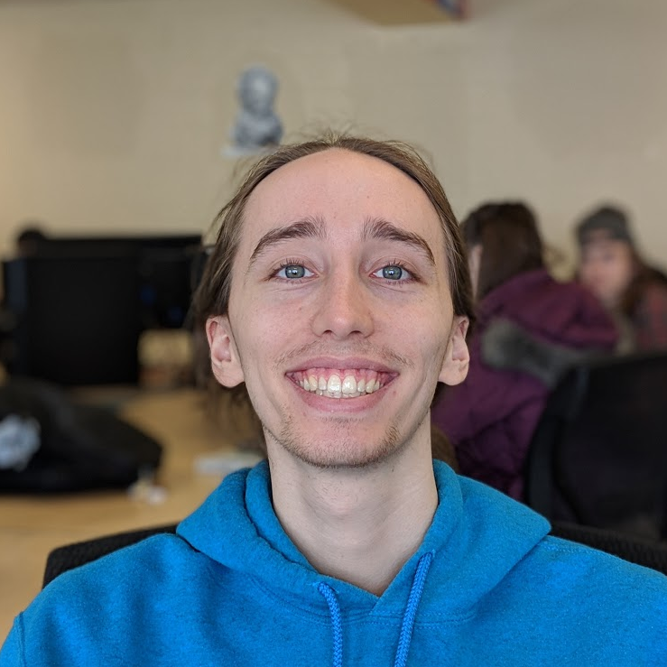
User Study
All our users knew how to play chess before being introduced to the prototype.
We forbid all users to move when playing to make sure the game could be played only using their voice
They ran into some issues when trying to give coordinates for pieces.
Some would repeat the command to as they thought the chess board did not understand, although it did and was slow to process
Cooper Harasyn, one of our users

Slide 7
Future Goals
Aesthetics
Audio Output

Slide 8
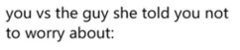
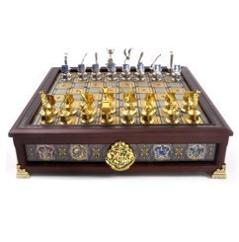
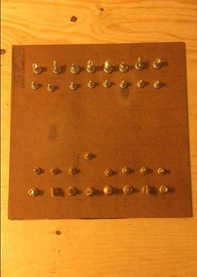
Aesthetics

Slide 9

Audio Output
Input validity confirmation
Music
Sound effects

Slide 10
Beyond the Project...
Functionality:
Implement moves like castling and en-passant
Usability:
replace drawer tacks to make prototype more compact

Slide 11
Questions?

